Slide 1
Test and Debug ASP.NET
Objectives:
Learn how to create ASP.NET web sites that run under IIS (local, remote, and FTP)
Practice testing an ASP.NET application with default and alternative browsers and with IIS.
Use the Debugger.
Use the Trace Feature

Slide 2
Create a Local IIS Web Site
Start to create a new web application.
When the New Web Site dialog box displays, select the ASP.NET Web Site template as shown and then in the Location drop-down list control select HTTP instead of File System or FTP as shown in this figure.

Slide 3
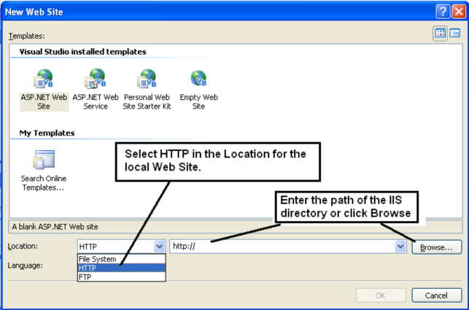

Slide 4
Enter the path of the IIS directory or click Browse. The Browse button displays the Choose Location dialog box shown in this figure.

Slide 5
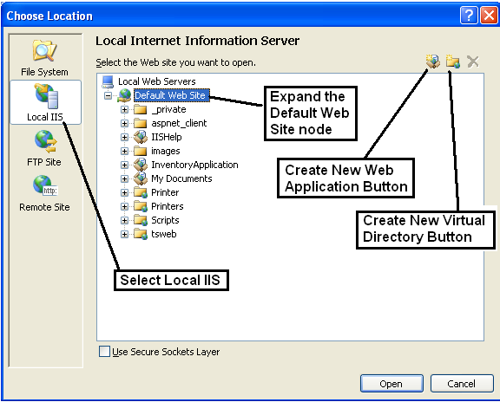

Slide 6
In the above figure the Default Web Site directory was selected. When the Open button is clicked, control returns to the New Web Site dialog box and the TextBox used to enter the path has the value:
http://localhost
The Choose Location dialog box also provides buttons as shown in the figure for options to Create New Web Application or Create New Virtual Directory.
Create New Web Application creates a new IIS directory for the web site. The files for the web site will be stored in the new directory.
Create New Virtual Directory can be used to select and map ANY directory on your computer to a virtual directory – the actual web site files are on one directory, but the virtual directory makes it look like the files are stored as part of the web site.

Slide 7
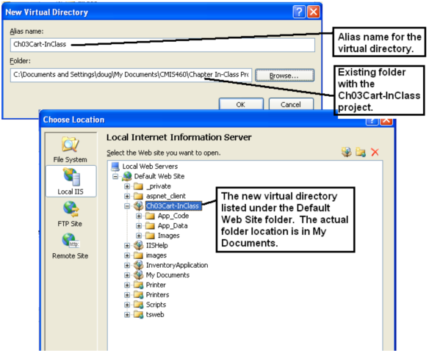

Slide 8
Test ASP.NET Applications
Testing and debugging initially for an ASP.NET application generally proceeds in three steps:
Within Visual Studio use the default web browser (Visual Studio uses Internet Explorer as the default unless this setting is modified on your client computer), and for file system web sites, the internal ASP.NET Development Web Server (instead of IIS).
Next determine if the application works correctly for other web browsers such as Mozilla Foxfire or whatever other browser your organization regularly uses.
Last, test the application from outside of Visual Studio in a test environment that mimics the target production environment.

Slide 9
How to enable debugging
The first time you run a web application, Visual Studio displays a dialog box stating that debugging is not enabled in the web.config file.
You need to enable debugging in order to use the debugger.
Before porting the application to a production server, debugging should be disabled by modifying the web.config file.

Slide 10
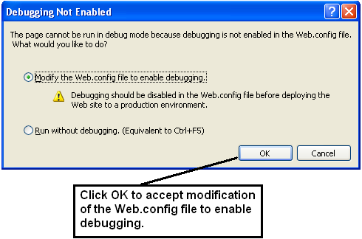
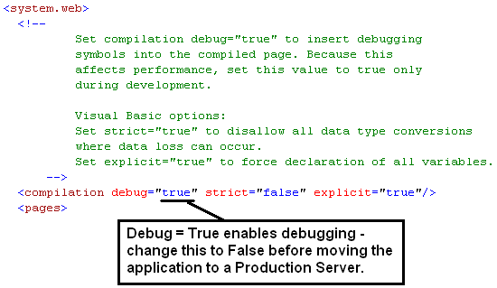

Slide 11
With and Without Debugging Options
Three ways to run an application with debugging are:
Choose the Debug menu, Start option.
Press F5 function key.
Click the Start Debugging button on the Standard toolbar.
Three ways to run an application without debugging are:
Choose the Debug menu, Start Without Debugging option.
Press Ctrl + F5 function key.
Right-click a page in Solution Explorer → choose the View in Browser option.

Slide 12
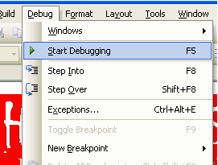

Slide 13
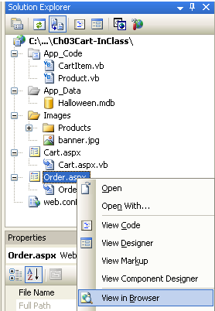
The View in Browser option will start the selected page and is used to primarily test a page's layout appearance.

Slide 14
Three ways to stop an application that's running with debugging are:
Choose Debug menu, Stop Debugging option.
Press Shift + F5.
Click the Stop Debugging button on the Debug toolbar.

Slide 15
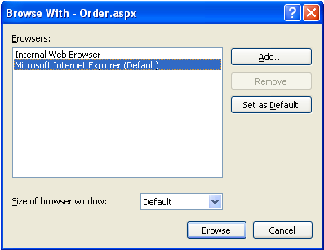
Use Alternative Web Browsers During Testing
To use an alternative web browser:
Right-click the start page in Solution Explorer.
Choose the Browse With option.
The Browse With dialog box displays and allows you to choose the alternative web browser.

Slide 16
Test a File-System Web Site with IIS
File system web sites run under the ASP.NET Development (Web) Server by default.
Need to test the web site under IIS because of limitations in the ASP.NET Development (Web) Server. These limitations include:
Only serves pages to the local computer.
Runs in current user's security context – need to run under other security contexts to adequately test security.
Does not include an SMTP server for testing email applications.
Uses a randomly chosen port instead of the HTTP standard of port 80.
Create a virtual directory for the web site as covered earlier in these notes.
Opening the page from its virtual directory will cause the web site to run under IIS.

Slide 17
Test an Application Outside of Visual Studio
The steps required to run an IIS application outside of Visual Studio are:
Open the web browser (such as Mozilla Foxfire).
Enter the URL for the starting page and press Enter.
Test the application on two or more browsers simultaneously to test for concurrency errors – those caused by concurrent access to resources such as databases.

Slide 18
Exception Assistant
Uncaught ASP.NET coding exceptions cause applications to enter break mode – the Exception Assistant displays a dialog box as shown in this figure.

Slide 19
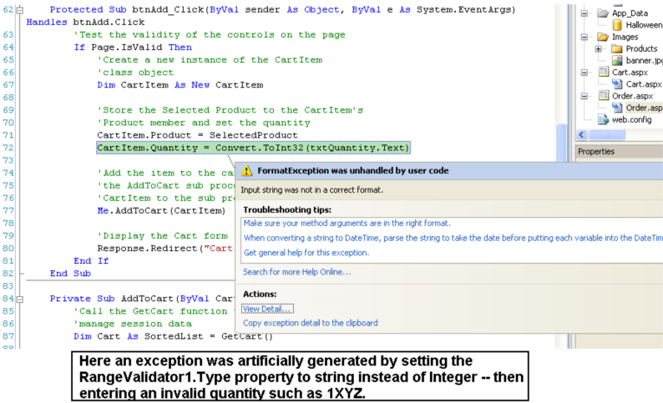

Slide 20
Use the Server Error Page
Runtime errors throw exceptions. Untrapped exceptions cause ASP.NET to terminate the application and display a Server Error Page to the web browser like that shown in this figure (this error was generated by disabling the range validator for the txtQuantity TextBox control on the Order.aspx page).

Slide 21
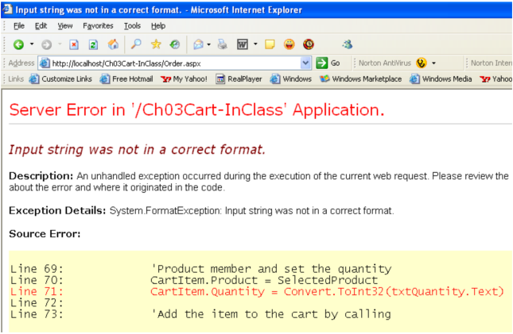

Slide 22
Use the Debugger
Use Breakpoints, Tracepoints, and Break Mode
Breakpoints are defined points in programming code were execution at runtime will "break" and the program will proceed in break mode allowing debugging to proceed by executing the program line-by-line.
To set a breakpoint:
Click the margin indicator bar left of the statement where you want the break to occur.
A large red dot will appear as shown in the figure below.
Multiple breakpoints allow breaking at the first point, then opting to continue the program to the next break.
The current line of execution is highlighted in yellow background.
Clear breakpoints by clicking the red dot again or by selecting the Debug menu, Clear All Breakpoints option.
Temporarily disable and enable breakpoints – select the Debug menu, Disable All Breakpoints or Enable All Breakpoints options.

Slide 23
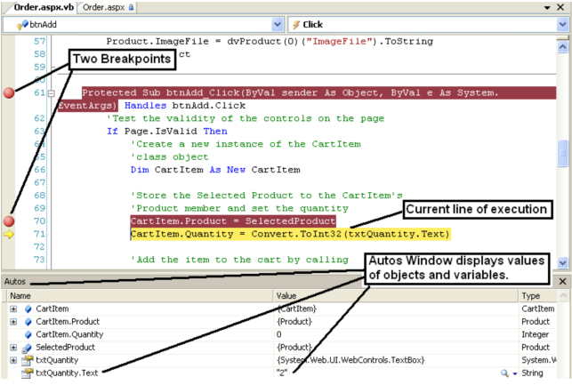

Slide 24
A tracepoint is a special breakpoint that performs an action when it is encountered.
If ASP.NET encounters a tracepoint, it performs the action and continues execution.
Tracepoints are usually used to display messages in the Immediate window – messages include text, values, and special keywords.
Tracepoints can be used to run macros.
To set a tracepoint:
Right-click the line of code where you want the tracepoint and choose Breakpoint->Insert Tracepoint as shown in this figure.

Slide 25
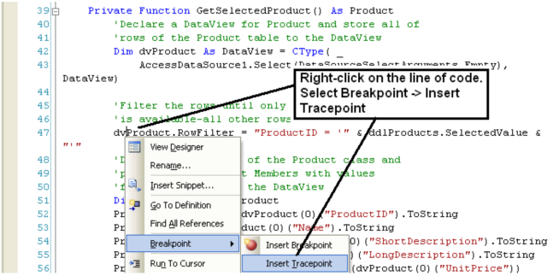

Slide 26
Complete the When Breakpoint Is Hit dialog box as shown here. Text is printed (the words Value of Product ID SelectedValue is: ) along with the value of the SelectedValue property of ddlProducts – note that variables and expressions must be coded within curly braces { } .
Break mode can be entered by unchecking the Continue Execution CheckBox option.
Output of a tracepoint displays to the Immediate window as shown in this figure. This shows the SelectedValue property value after selecting two different products on the Orders.aspx page of the Shopping Cart web site.
Coding lines with tracepoints that continue execution when hit are marked with a large red diamond instead of a red dot.

Slide 27
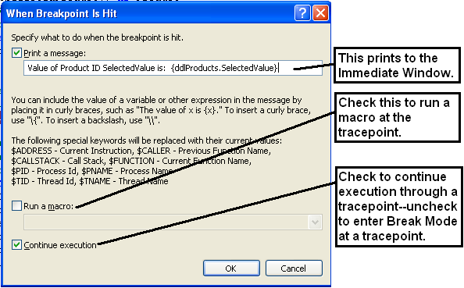


Slide 28
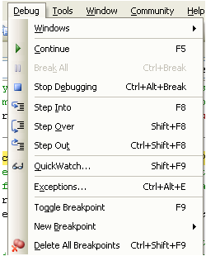
Using Break Mode: when using break mode there are a number of techniques you can use:
The debugger highlights the next statement to be executed in a yellow background.
The Debug menu allows you to step to the next statement, step into a called procedure, step over a called procedure, or step out of the current procedure.

Slide 29
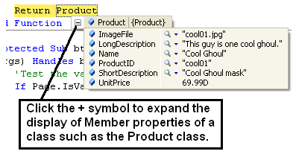
Positioning the mouse pointer over a variable or property in the code editor window displays the value of the variable/property. If the object is an array, structure or object with member variables/properties, you can point to the plus sign in the data tip to display member values as shown here.

Slide 30
Use the Autos, Locals, and Watch Windows
Window | Description
Autos | Displays information about variables, properties, and constants for the current coding line and three statements before and after the current coding line.
Locals | Displays same information as the Autos window but within scope of the current procedure (displays MORE information than Autos).
Watch | Lets you view specific variables and expressions that you specify called watch expressions – you can have up to four Watch windows.

Slide 31
To add a watch expression:
Set a breakpoint in the application where desired for testing.
Run the application.
When the application execution breaks, type the variable name or expression into the Name column of a watch window, or drag/drop the variable in the Code Window to the watch window, or right-click a variable or highlighted expression and choose Add Watch as shown here.
The expression that you enter does not have to exist within the code in order to display a value.

Slide 32
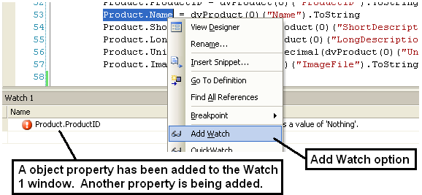

Slide 33
Use the Trace Feature
The Trace feature traces execution of a page and displays information at the bottom of that page.
Trace is enabled by adding a Trace attribute to the Page directive at the top of an aspx file – the Trace="True" attribute.
Open the web site page in Source view.
Modify the Page directive by adding the Trace attribute as shown here.
<%@ Page Language="VB" AutoEventWireup="false" CodeFile="Order.aspx.vb" Inherits="Order" Trace="True"%>
Trace has to be turned on (True) for every page on which you want to obtain trace information.
Trace information is displayed at the bottom of a web site page and is divided into several tabular displays as shown here—this figure only displays two of the tables. One of the interesting tables is the Session State that provides information about items in session state.

Slide 34
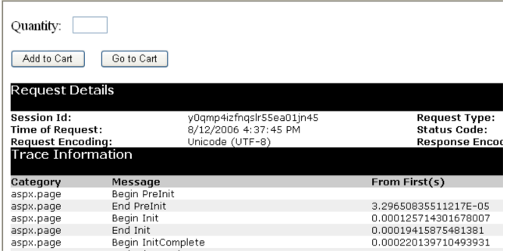

Slide 35
Create Custom Trace Messages
The TraceContext object can be used to write custom messages to the trace output.
The TraceContext object is available as a page's Trace property.
You can use the Write method to write to trace output.
You can use the Warn method to write a message in red type to the trace output.
Trace messages are only written when a page has trace enabled.

Slide 36
This code and the accompanying figure shows coding trace message testing in the Page_Load event and the output in the Trace Information table.
Protected Sub Page_Load(ByVal sender As Object, ByVal e As System.EventArgs) Handles Me.Load
'The first time the page loads bind the
'DropDownList control
If Not IsPostBack Then
Me.ddlProducts.DataBind()
End If
'Write to Trace.
If Trace.IsEnabled Then
Me.Trace.Write("Page_Load Event", "Binding Products Drop-DownList")
Me.Trace.Warn("Page_Load Event", "This message is in red print")
End If

Slide 37
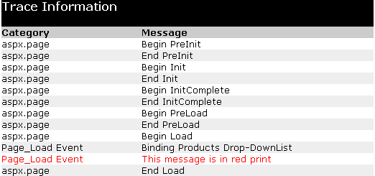

Slide 38
Write Information to the HTTP Output Stream
The Write method of the HTTP Response object can be used to write this output as shown in this example:
This is the Page_Load event for the Cart.aspx web page.
Code can include HTML tags.
In this example the <br /> tag prints a blank line after the output.
Output displays directly on the web page.
Protected Sub Page_Load(ByVal sender As Object, ByVal e As System.EventArgs) Handles Me.Load
'Call the GetCart function to retrieve the
'shopping cart from session state
Cart = Me.GetCart()
'Call DisplayCart to display the cart values
If Not IsPostBack Then
Me.DisplayCart()
Me.Response.Write("Items in cart = " & Me.Cart.Count & "<br />")
End If
End Sub

Slide 39
